Slide 1

National University of Computer and Emerging Sciences
Introduction to Course
AI-5004 Adv. Topics in Generative AI
Presented By: Dr. Muhammad Nouman Noor
Department of AI and Data Science
Developed By. Dr. Akhtar Jamil

Slide 2
Goals
Review of Previous Lecture
Modelling Probability Distribution
Bayesian Networks

Slide 3
Review of Previous Lecture

Slide 4
What is Machine Learning?
A branch of artificial intelligence that enables systems to learn and improve from experience without being explicitly programmed.
Key Components:
Data: Essential for training models.
Algorithms: Learn from data to make predictions or decisions.
Types of Machine Learning:
Supervised Learning: Learning with labeled data.
Unsupervised Learning: Learning from unlabeled data to find patterns.
Reinforcement Learning: Learning by trial and error to achieve a goal.

Slide 5
Deep Learning
Uses complex neural networks with many layers (deep neural networks).
These networks are capable of automatically discovering and learning patterns in data
Superior performance on tasks like image and speech recognition.
Deep learning models can automatically extract and learn features from raw data, reducing the need for manual feature extraction.

Slide 6
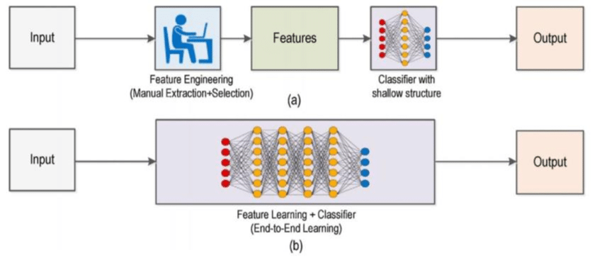
Machine Learning vs Deep Learning

Slide 7
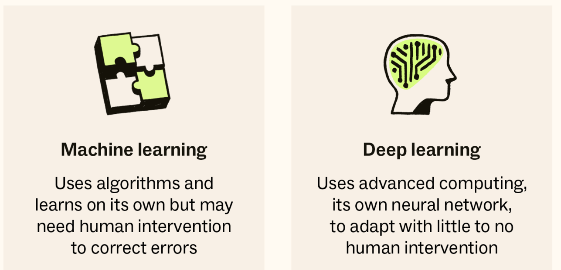
Machine Learning vs Deep Learning

Slide 8
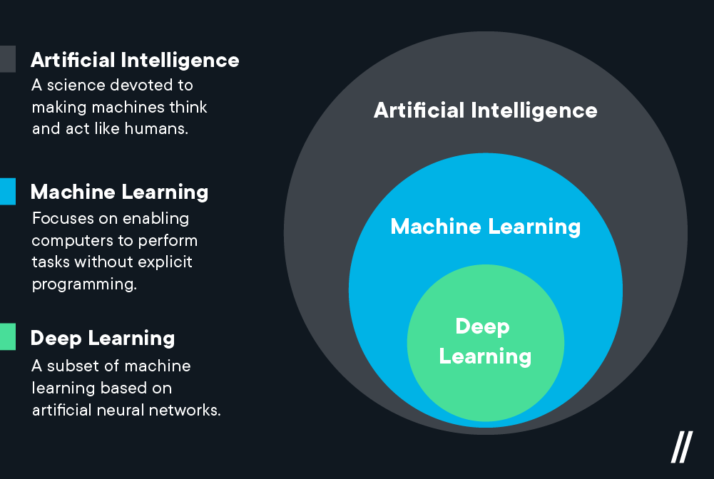
Artificial Intelligence

Slide 9
Today’s Lecture

Slide 10
What are Generative Models?
Generative models are a class of statistical models used in machine learning that focus on the generation of new data instances.
Generative models used in unsupervised machine learning.
They try understanding and replicating the complex probability distributions of training data.
Capture the essence of data - its patterns, variations, and structure - and can produce new data that follows the same statistical properties.
They contrast with discriminative models, which are designed to distinguish between different kinds of data instances.

Slide 11
Discriminative Vs Generative Model
Generative Models
Generative learn the joint probability distribution P(X, Y) , where X is the input data and Y is the output label.
They understand how the data is generated in terms of a probabilistic model.
These models can generate new data points that is similar to the training data.
e.g. Gaussian Mixture Models, Hidden Markov Models, Naive Bayes, Variational Autoencoders (VAEs), and Generative Adversarial Networks (GANs).

Slide 12
Discriminative Vs Generative Model
Discriminative Models
Discriminative models learn the conditional probability P(Y | X) , which is the probability of the output label Y given the input data X .
They focus on the boundary between classes.
These models are used to distinguish between different types of data points.
They do not inherently generate new data points but classify input data into predefined categories.
Examples include Logistic Regression, Support Vector Machines, Decision Trees, and most of the Neural Networks used for classification tasks.

Slide 13

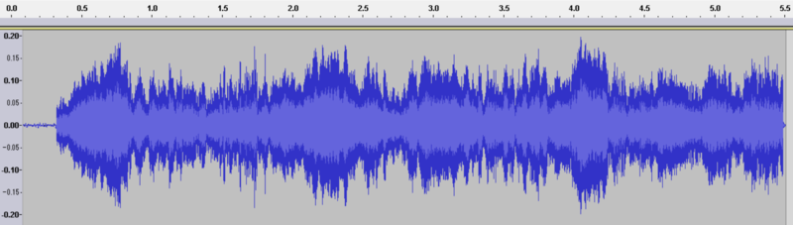
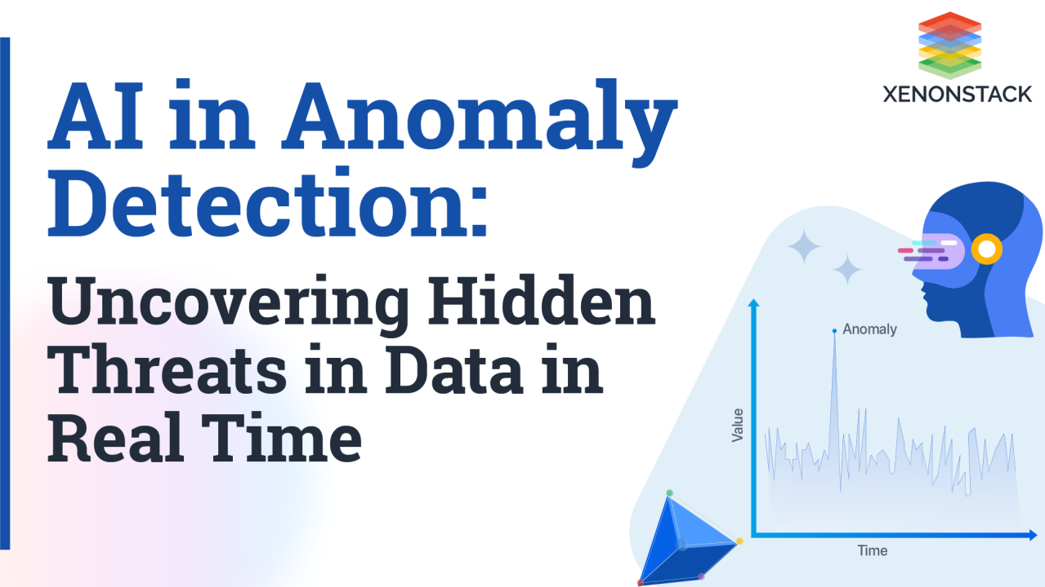
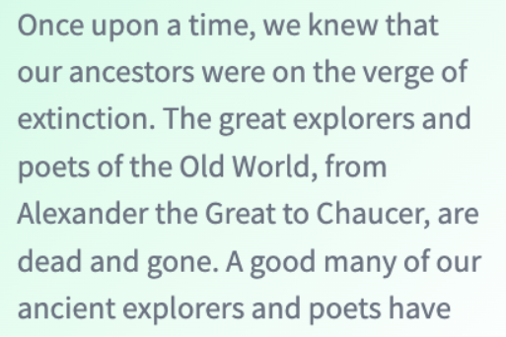
What are Generative Models?
Generative machine learning algorithms model complex, high-dimensional objects.
Human Speech
High-Resolution Images
Paragraphs of Text
Notes:
Problem: making sense of complex, unstructured sensory inputs. Images, speech, text, video, etc.
https://commons.wikimedia.org/wiki/Language#/media/File:Floor_7a_bookstacks_in_Sterling_Memorial_Library.jpg
https://commons.wikimedia.org/wiki/File:EmiMa-099-semantic-segmentation.png
https://commons.wikimedia.org/wiki/File:Waveform_of_Habana_syndrome_sound.png
https://commons.wikimedia.org/w/index.php?title=Special:Search&limit=500&offset=0&ns0=1&ns6=1&ns12=1&ns14=1&ns100=1&ns106=1&search=Autonomous+cars&advancedSearch-current={}

Slide 14
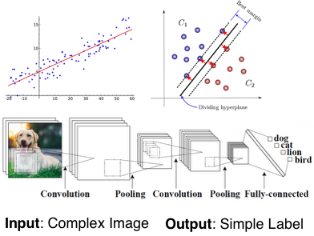
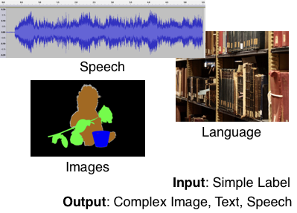
What are Generative Models?
Generative machine learning algorithms model complex, high-dimensional objects.
Discriminative Models
Generative Models
Notes:
Problem: making sense of complex, unstructured sensory inputs. Images, speech, text, video, etc.
https://commons.wikimedia.org/wiki/Language#/media/File:Floor_7a_bookstacks_in_Sterling_Memorial_Library.jpg
https://commons.wikimedia.org/wiki/File:EmiMa-099-semantic-segmentation.png
https://commons.wikimedia.org/wiki/File:Waveform_of_Habana_syndrome_sound.png
https://commons.wikimedia.org/w/index.php?title=Special:Search&limit=500&offset=0&ns0=1&ns6=1&ns12=1&ns14=1&ns100=1&ns106=1&search=Autonomous+cars&advancedSearch-current={}

Slide 15
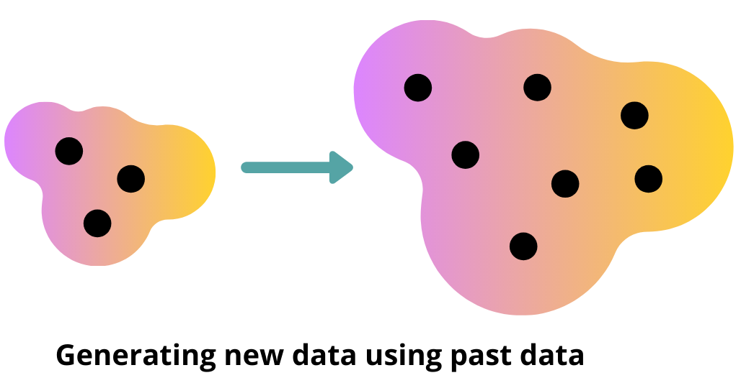
Discriminative vs. Generative Models
Generative models can do everything that discriminative models can do: e.g., prediction (can get conditional p(y|x) from p(x,y) via Bayes’ rule).
But generative models can also do much more!
Generating new x’s
Handling missing inputs in x

Slide 16
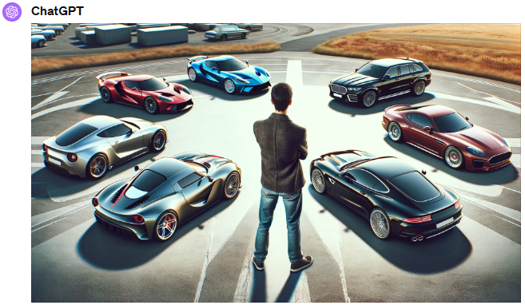
Discriminative vs. Generative Models
“generate an image of a person with six cars”
Generative Model

Slide 17

Discriminative vs. Generative Models
A generative model can also be used for prediction, because we can derive the conditional p(y|x) from the joint p(x,y) via Bayes’ rule.
A generative model can also do more!
Handling missing inputs in x
Generating new x’s
Conditional generation of p(x|y)
And much more!
P(X= | Caption = “A black table with 6 chairs”)

Slide 18



Generative Modeling: A Statistical & Probabilistic Approach
In the context, of probabilistic generative modeling:
Data: samples from data distribution (e.g., images of bedrooms)
Prior knowledge: parametric form of the model (e.g., Gaussian distribution), objective function (e.g., maximum likelihood), optimization algorithm, etc.
Output:
a probability distribution P( )
probability P(x) of image x
samples x from P
…
Notes:
We are concerned with statistical generative models
Graphics: purely based on prior knowledge. Difficult to scale. Developing the field took a very long time. Still not entirely solved, active area of research.
Motivation: Reduce the amount of prior knowledge and use data. (machine learning)
Note: cannot do something purely based on data. Known impossibility results. Even in discrete spaces, scaling of sample complexity would be doubly-exponential.

Slide 19
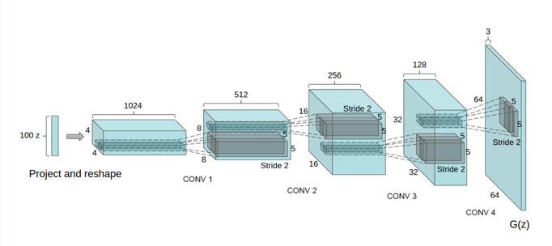
Deep Generative Models
The probability distribution p(x) will be specified using deep neural networks
High-Dimensional
Image
Latent Vector
Representation
Sequence of Convolutional Upsampling Layers
Radford et al.

Slide 20
Applications of Deep Generative Models

Slide 21

Generative Art
“generate an art containing mountains and a small house”
ChatGPT-4

Slide 22
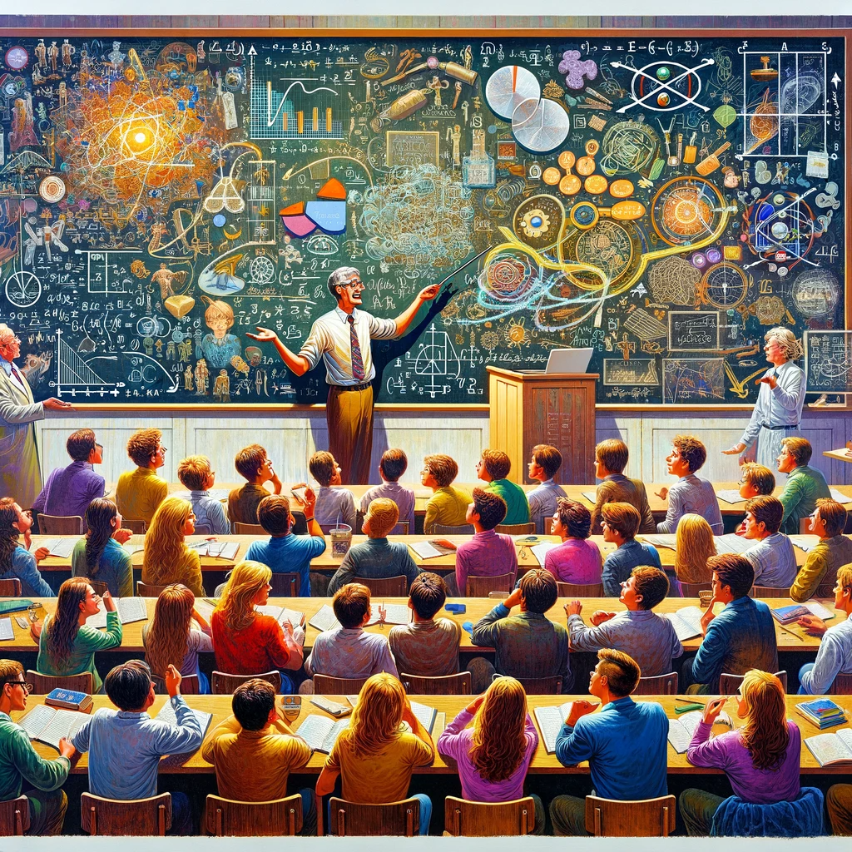
Generative Art
“Generate an art where a professor explains a hard topic and students are enjoying”
ChatGPT-4

Slide 23
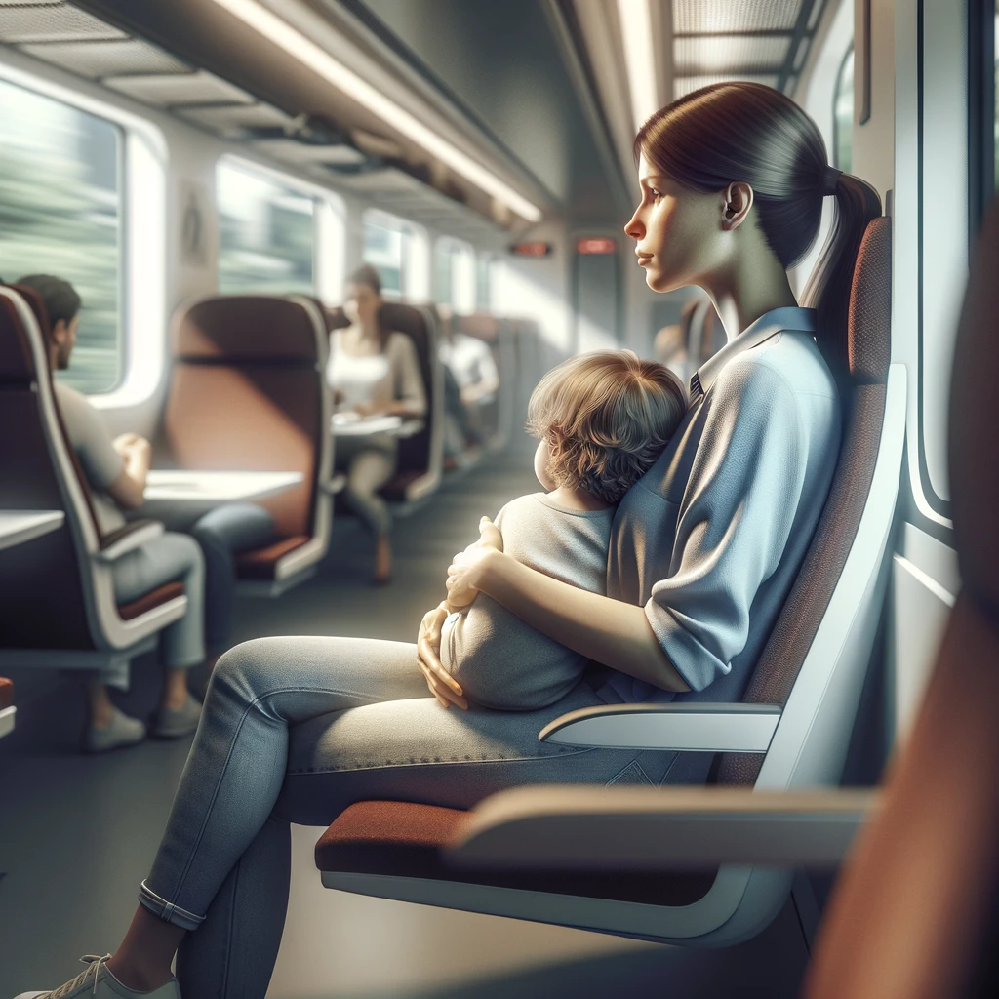

Generating Photorealistic Human Faces
“Generate a realistic Image of a woman with a child in her hand sitting on a train ”
ChatGPT-4
Generating Photorealistic Human Face
Notes:
https://www.youtube.com/watch?v=XOxxPcy5Gr4

Slide 24
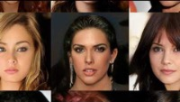
Generating Photorealistic Human Faces
Karras et al., 2018
Notes:
https://www.youtube.com/watch?v=XOxxPcy5Gr4

Slide 25
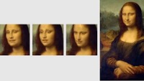
Living Portraits
Samsung AI Lab

Slide 26
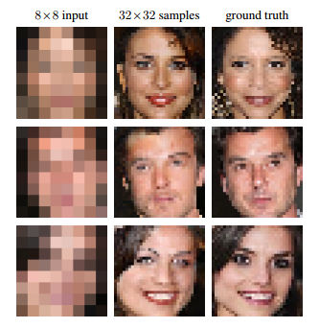
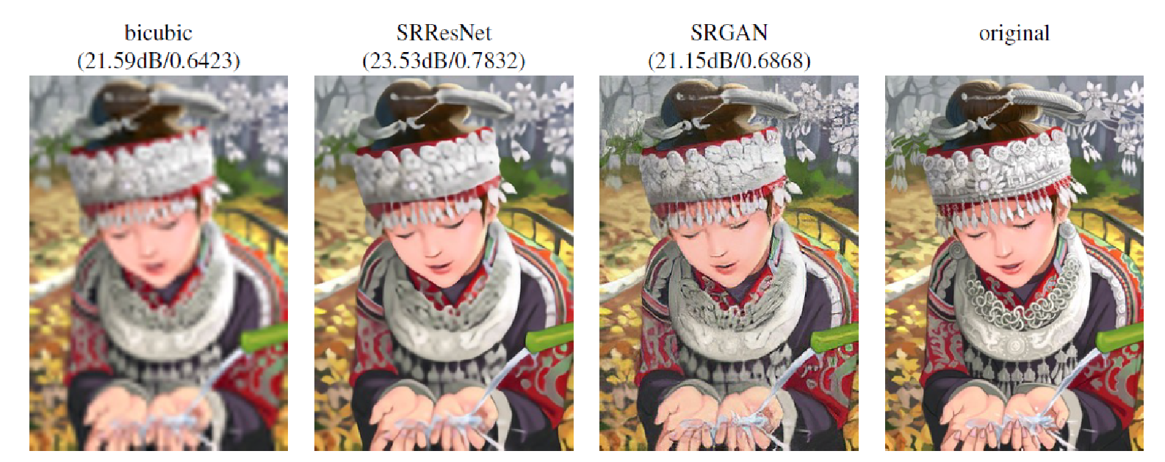
Image Enhancement and Super-Resolution
Uses a conditional generative model P( high res image | low res image)
Ledig et al., 2017

Slide 27

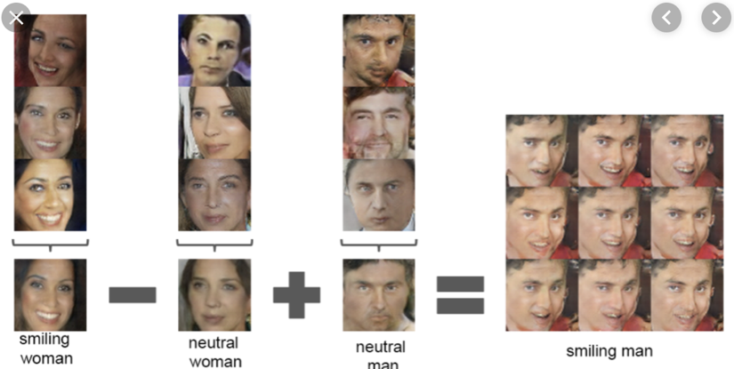
Representation Learning
Here, the generative models learns high-level concepts from data (similing, man, woman, etc.). We can use these to perform complex semantic manipulations over images.
Radford et al.

Slide 28


Generating Realistic Human Speech
Generative model of speech signals
Text to Speech
Parametric
Concatenative
WaveNet
Unconditional
Music
van den Oord et al, 2016c
Notes:
https://deepmind.com/blog/wavenet-generative-model-raw-audio/

Slide 29
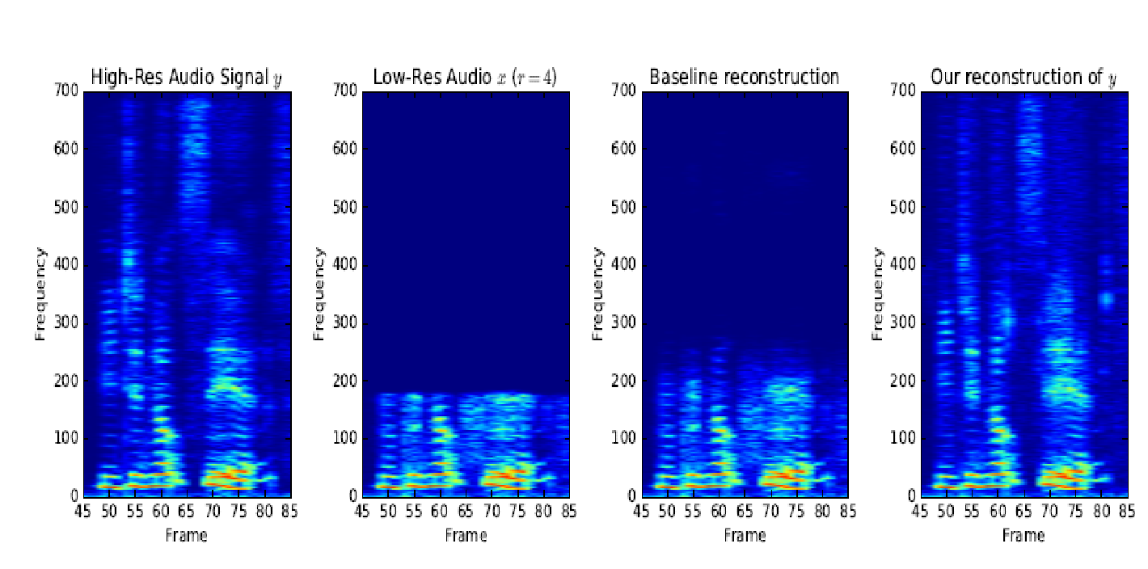
Signal Processing and Signal Enhancement
Audio super-resolution using a conditional model P(high-res | low-res audio signal).
Low-res signal
High-res audio signal
Kuleshov et al., 2017

Slide 30
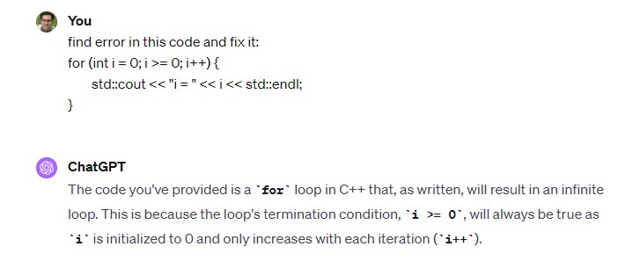
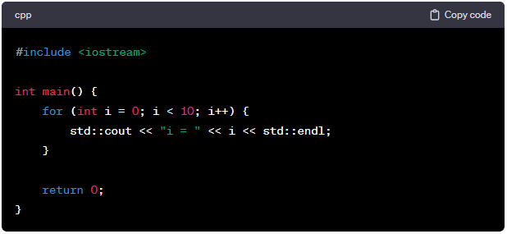
Language Generation

Slide 31
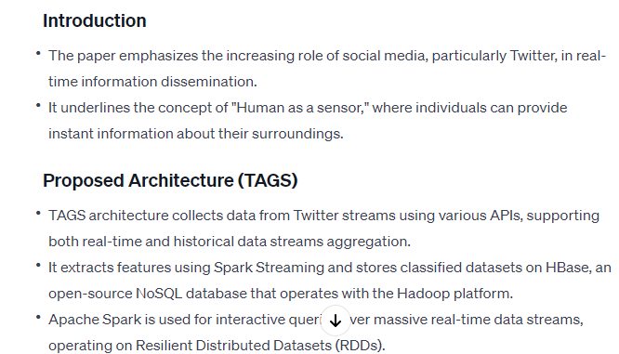
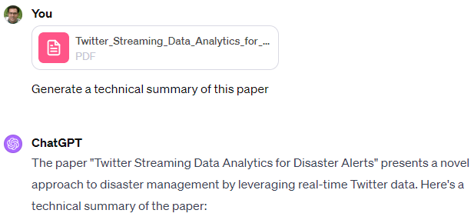
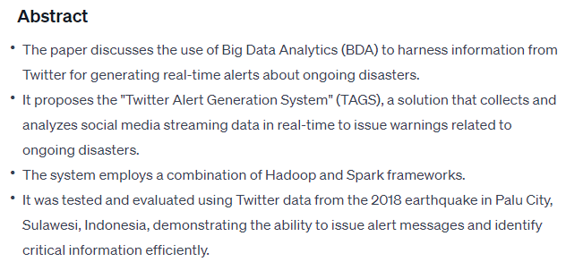
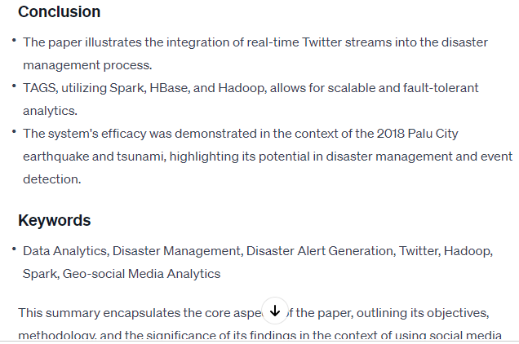

Slide 32
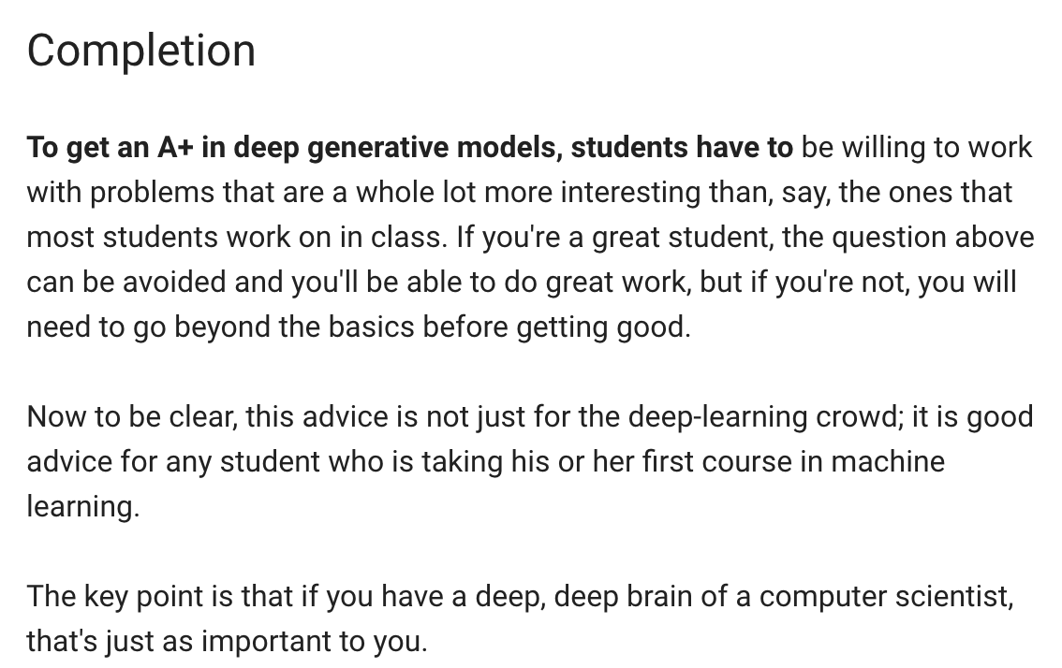
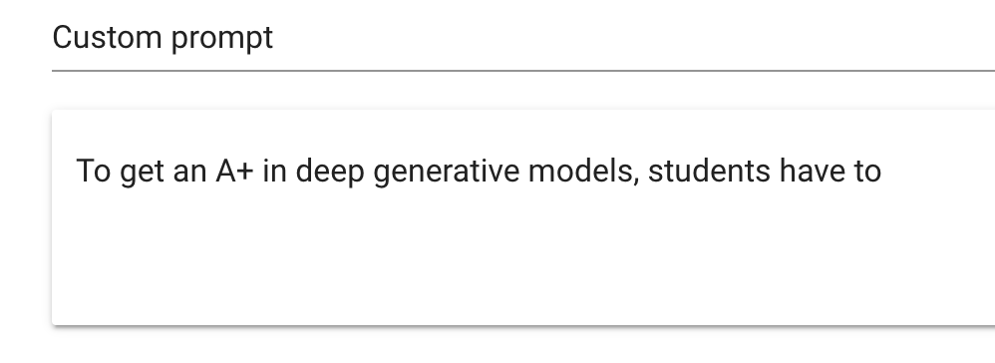
Language Generation
Radford et al., 2019
Demo from talktotransformer.com

Slide 33
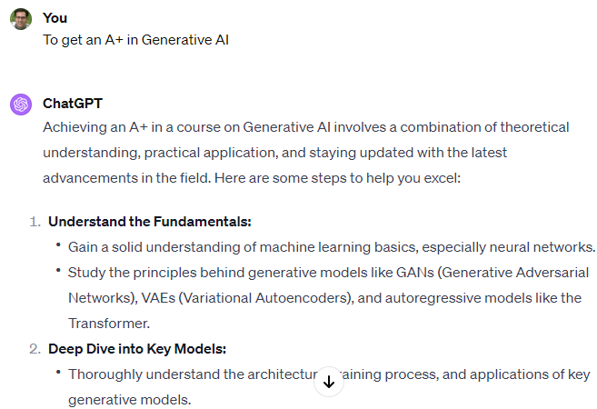
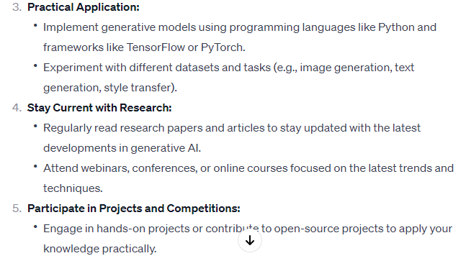
Language Generation

Slide 34
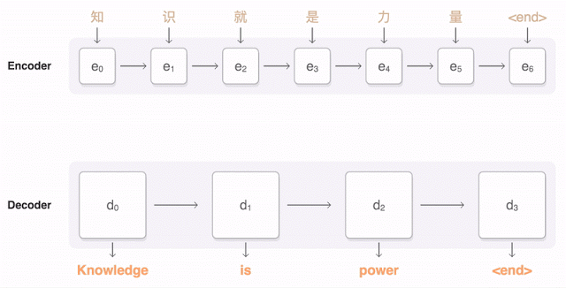
Machine Translation
Uses a conditional generative model P(English text | Urdu text).
Figure from Google AI research blog.

Slide 35

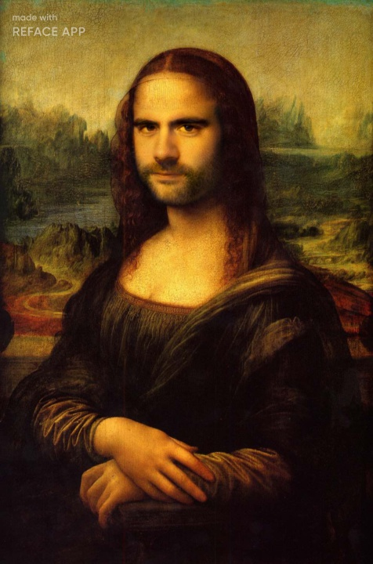

Deep Fakes & Face Swapping
Do you recognize anyone you know in these pictures?

Slide 36

Image Translation
Horse-to-zebra translation using a model P(zebra images | horse images).
Zhu et al., 2017
Notes:
https://www.youtube.com/watch?time_continue=1&v=9reHvktowLY

Slide 37
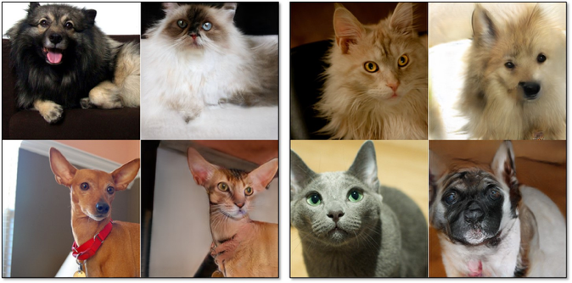
Image Translation
Dog-to-cat image translation using a model P(cat images | dog images)
Notes:
https://www.youtube.com/watch?time_continue=1&v=9reHvktowLY

Slide 38
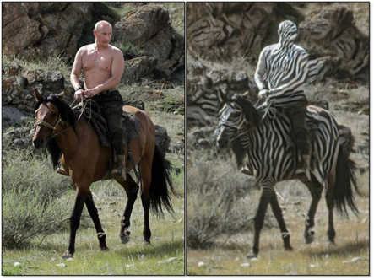
Failure Modes of Image Translation

Slide 39
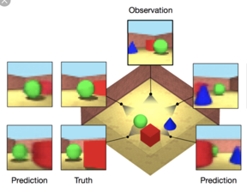
Decision-Making: Planning
An agent can use a generative model of the world to plan its actions.
Here, the model predicts the scene from different views. This helps the agent decide how to move in this simulated environement.

Slide 40
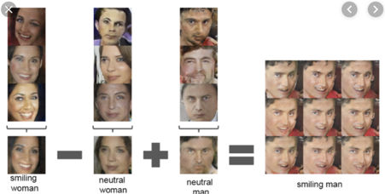
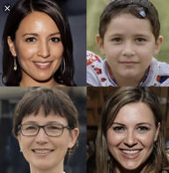
What Are Generative Models Useful For?
Generation and Manipulation
Super Resolution
Signal Processing
Signal Enhancement
Representation Learning
Style Transfer
Image Translation
Controlled generation
Decision-Making
Planning
Imitation Learning

Slide 41
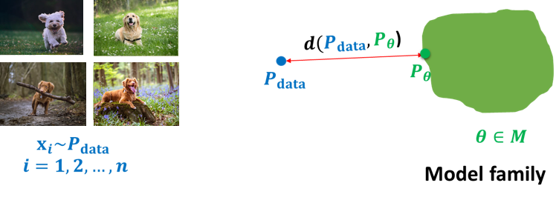
Learning a Generative Model
We are given a training set of examples, e.g., images of dogs
We want to learn a probability distribution p(x ) over images x such that
Generation: If we sample x_{new} ∼ p(x ), x_{new} should look like a dog (sampling)
Representation learning: We should be able to learn what these images have in common, e.g., ears, tail, etc. (features)
First step: how to represent p(x )

Slide 42
Learning a Generative Model
Defining Probabilistic Models of the Data
Examples of Probabilistic Models The Curse of Dimensionality
Parameter-Efficient Models Through Conditional Independence Bayesian Networks: An Example of Shallow Generative Models
Discriminative vs. Generative Models
Naive Bayes vs. Logistic Regression Which One to Use?
A First Glimpse of Deep Generative Models
3

Slide 43
Probabilistic Models: Basic Discrete Distributions
Bernoulli distribution: (biased) coin flip
Domain: {Heads, Tails}
Specify P(X = Heads) = p. Then P(X = Tails) = 1 − p. Write: X ∼ Ber (p) : only one parameter p
Sampling: flip a (biased) coin
Categorical distribution: (biased) m-sided dice
Domain: {1, · · · , m}
Σ
Specify P(Y = i ) = p_{i} , such that p_{i} = 1
Write: Y ∼ Cat(p₁, · · · , p_{m} ) : m-1 parameters
Sampling: roll a (biased) die

Slide 44
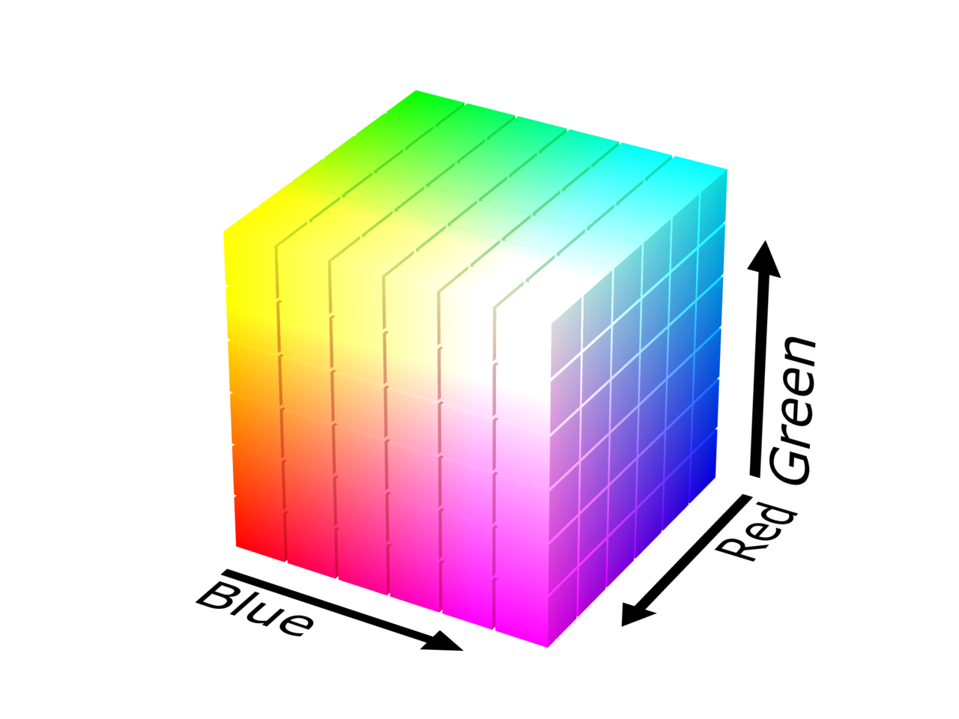
Probabilistic Models: A Multi-Variate Joint Distribution
Suppose we want to define a distribution over one pixel in an image. We use three discrete random variables:
Red Channel R. Val(R) = {0, · · · , 255}
Green Channel G . Val(G ) = {0, · · · ,255}
Blue Channel B. Val(B) = {0, · · · , 255}
Sampling from the joint distribution (r , g, b) ∼ p(R, G, B) randomly generates a color for the pixel.
How many parameters do we need to specify the joint distribution p(R = r , G = g, B = b)?
256 ∗ 256 ∗ 256 − 1

Slide 45
The Curse of Dimensionality in Probabilistic Models
Suppose we want to model a BW image of digit with n = 28 · 28 pixels.
Pixels X₁, . . . , X_{n} are modeled as binary (Bernoulli) random variables, i.e., Val(X_{i} ) = {0, 1} = {Black, White}.
How many possible states?
n
2 × 2 × · · · × 2 = 2
n times
Sampling from p(x₁, . . . , x_{n}) generates an image
How many parameters to specify the joint distribution p(x₁, . . . , x_{n}) over n binary pixels? 2^{n} − 1 (exponential) => curse of dimensionality

Slide 46

Parameter-Efficient Models Through Independence
If X₁, . . . , X_{n} are independent, then
p(x₁, . . . , x_{n}) = p(x₁)p(x₂) · · · p(x_{n})
How many possible states? 2^{n}
How many parameters to specify the joint distribution p(x₁, . . . , x_{n})?
How many to specify the marginal distribution p(x₁)? 1
2^{n} entries can be described by just n numbers (if |Val(X_{i} )| = 2)! Independence assumption is too strong. Model not likely to be useful For example, each pixel chosen independently when we sample from it.

Slide 47
References
Chapter 20, Deep Learning, MIT Press, Ian Goodfellow, Yoshua Bengio, Aaron Courville
Lecture slides of https://www.cs.cornell.edu/~kuleshov/

Slide 48
Thank You ☺

